Slide 1
Java EE Platform
Lecturer: Ngo Huy Bien
Software Engineering Department
Faculty of Information Technology
University of Science
Ho Chi Minh City, Vietnam
nhbien@fit.hcmus.edu.vn

Slide 2

Objectives
To create a WordPress theme

Slide 3

References
Mark Heckler (2021). Spring Boot - Up and Running - Building Cloud Native Java and Kotlin Applications. O'Reilly Media.

Slide 4
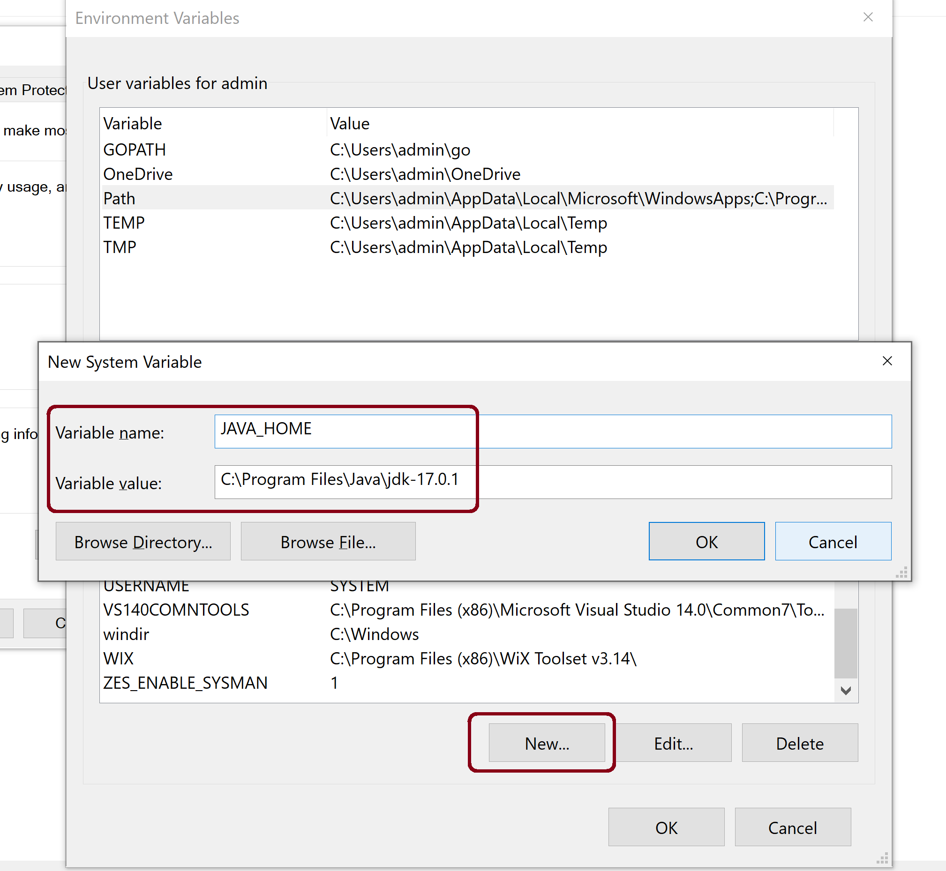
1. Add JAVA_HOME Variable

Slide 5
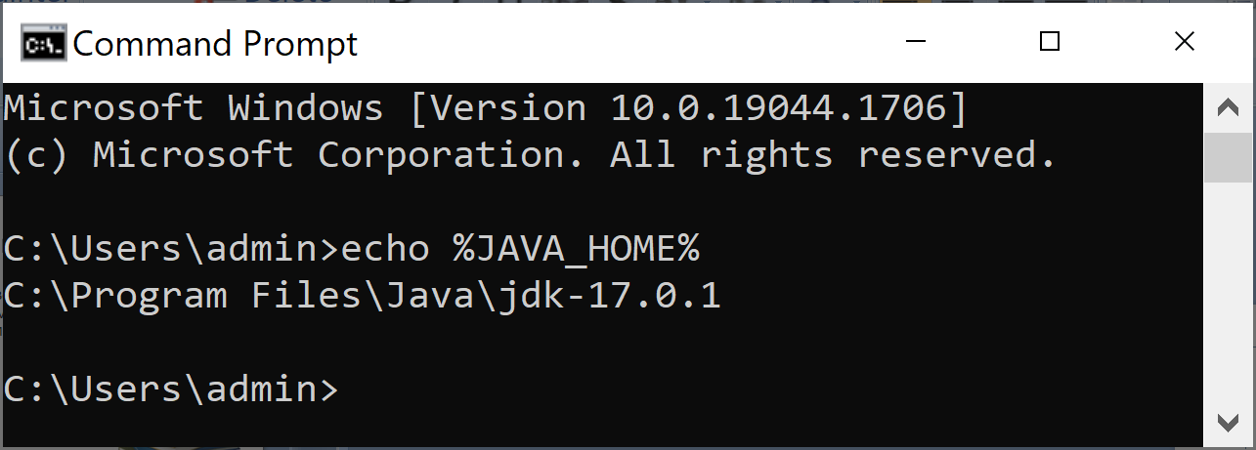
2. Verify JAVA_HOME Variable
echo %JAVA_HOME%

Slide 6
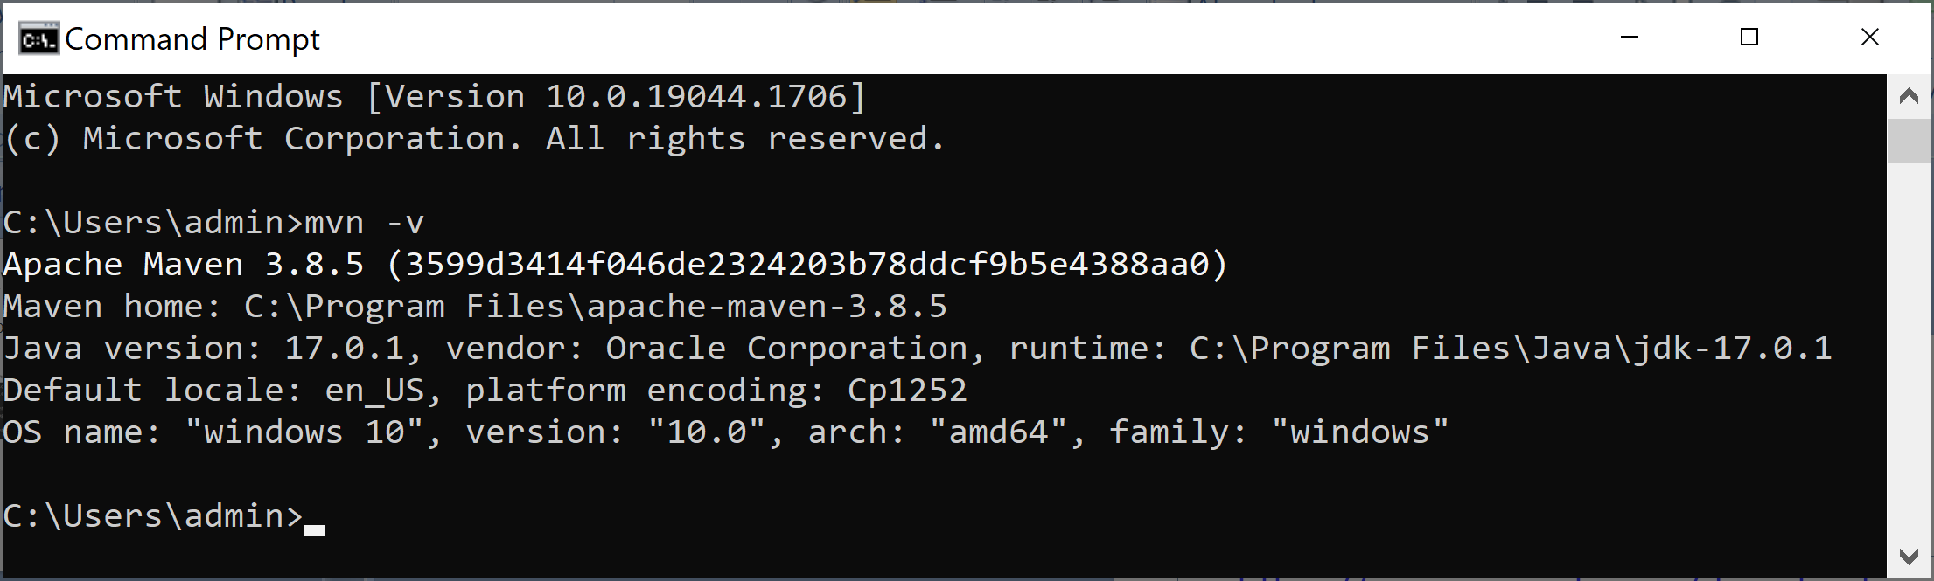
3. Install Maven
https://maven.apache.org/download.cgi
Extract the zip file to C:\Program Files\apache-maven-3.8.5
Add C:\Program Files\apache-maven-3.8.5\bin to SYSTEM PATH.
mvn -v

Slide 7
4. Install Gradle
https://gradle.org/install/
Extract the zip file to C:\Gradle\gradle-7.4.2
Add C:\Gradle\gradle-7.4.2\bin to SYSTEM PATH.
gradle -v

Slide 8
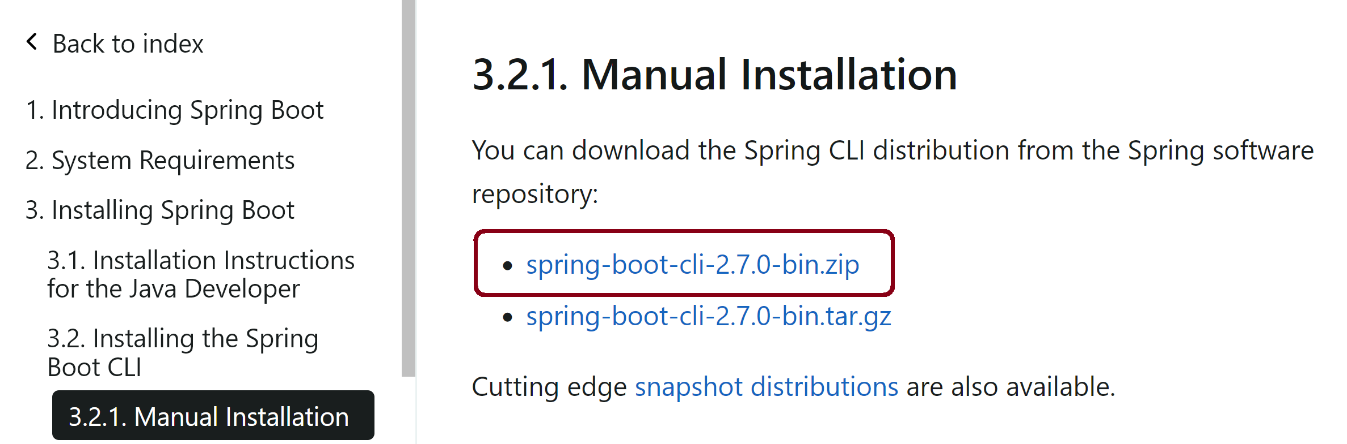
4. Download Spring Boot CLI
https://docs.spring.io/spring-boot/docs/current/reference/html/getting-started.html#getting-started.installing.cli
The Spring Boot CLI (Command Line Interface) is a command line tool that you can use to quickly prototype with Spring.
You do not need to use the CLI to work with Spring Boot, but it is a quick way to get a Spring application off the ground without an IDE.

Slide 9
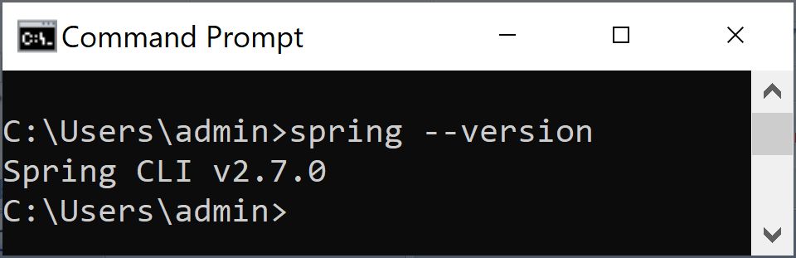
5. Install Spring Boot CLI
Add C:\Program Files\spring-2.7.0\bin to SYSTEM PATH
spring --version

Slide 10
This page intentionally left blank.

Slide 11
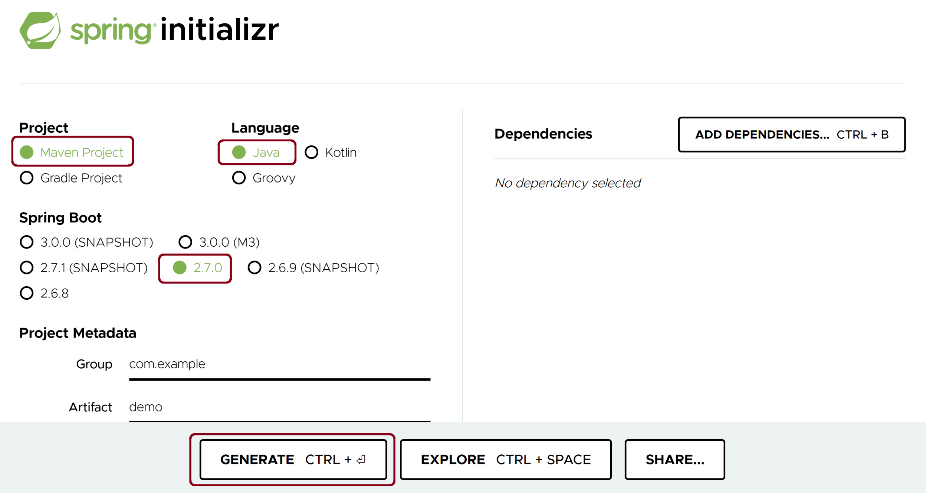
1. Create a Spring Project [1]
https://start.spring.io/

Slide 12
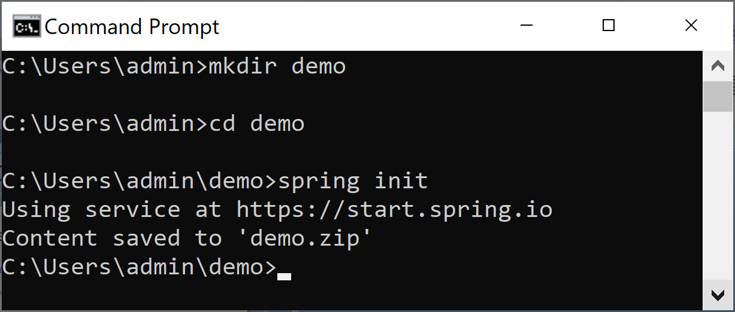
2. Create a Spring Project using CLI
mkdir demo
cd demo
spring init
spring init -a demo -l java --build maven demo

Slide 13
3. Install IntelliJ IDEA
https://www.jetbrains.com/idea/download
See 10. Introduction To Java.pptx for detail.

Slide 14
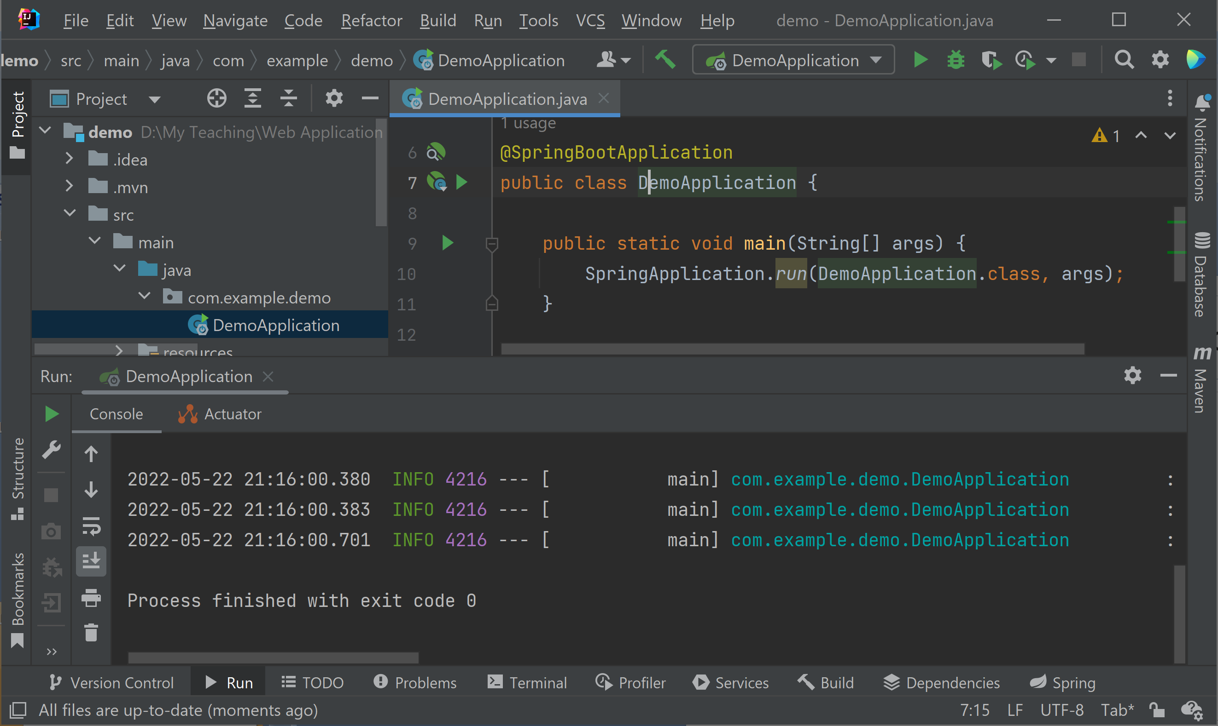
4. Run the Demo Project

Slide 15


Slide 16
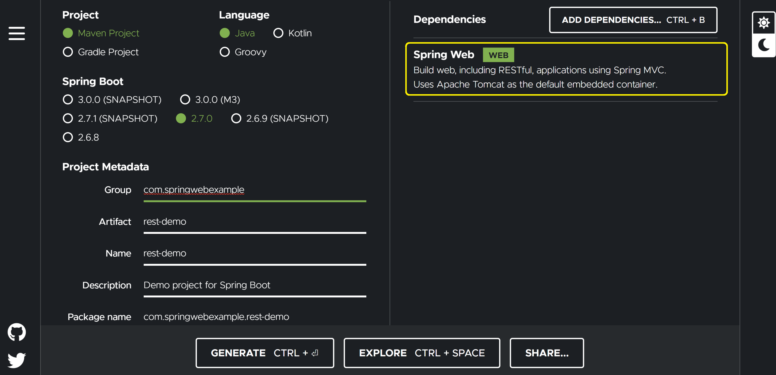
1. Create a Project with Spring Web
https://start.spring.io/

Slide 17
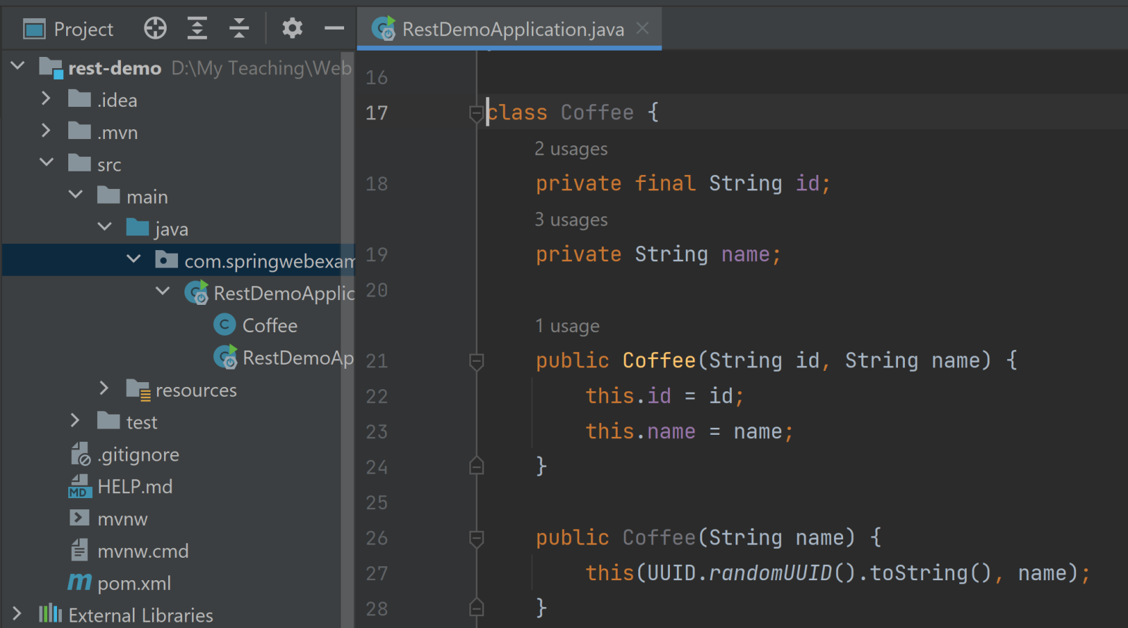
2. Create the Coffee Class

Slide 18
3. Create the RestApiDemoController Class
@RestController class RestApiDemoController { private List<Coffee> coffees = new ArrayList<>(); public RestApiDemoController() { coffees.addAll(List.of( new Coffee("Café Cereza"), new Coffee("Café Ganador"), new Coffee("Café Lareño"), new Coffee("Café Três Pontas") )); } }

Slide 19
4. Add the @RequestMapping Annotation
class RestApiDemoController { private List<Coffee> coffees = new ArrayList<>();
...
@RequestMapping(value = "/coffees", method = RequestMethod.GET) Iterable<Coffee> getCoffees() { return coffees; } }

Slide 20
5. Add the the Class-Level @RequestMapping Annotation
@RestController @RequestMapping("/coffees") class RestApiDemoController { private List<Coffee> coffees = new ArrayList<>();
...
@GetMapping Iterable<Coffee> getCoffees() { return coffees; } @GetMapping("/{id}") Optional<Coffee> getCoffeeById(@PathVariable String id) { for (Coffee c: coffees) { if (c.getId().equals(id)) { return Optional.of(c); } } return Optional.empty(); }
...

Slide 21
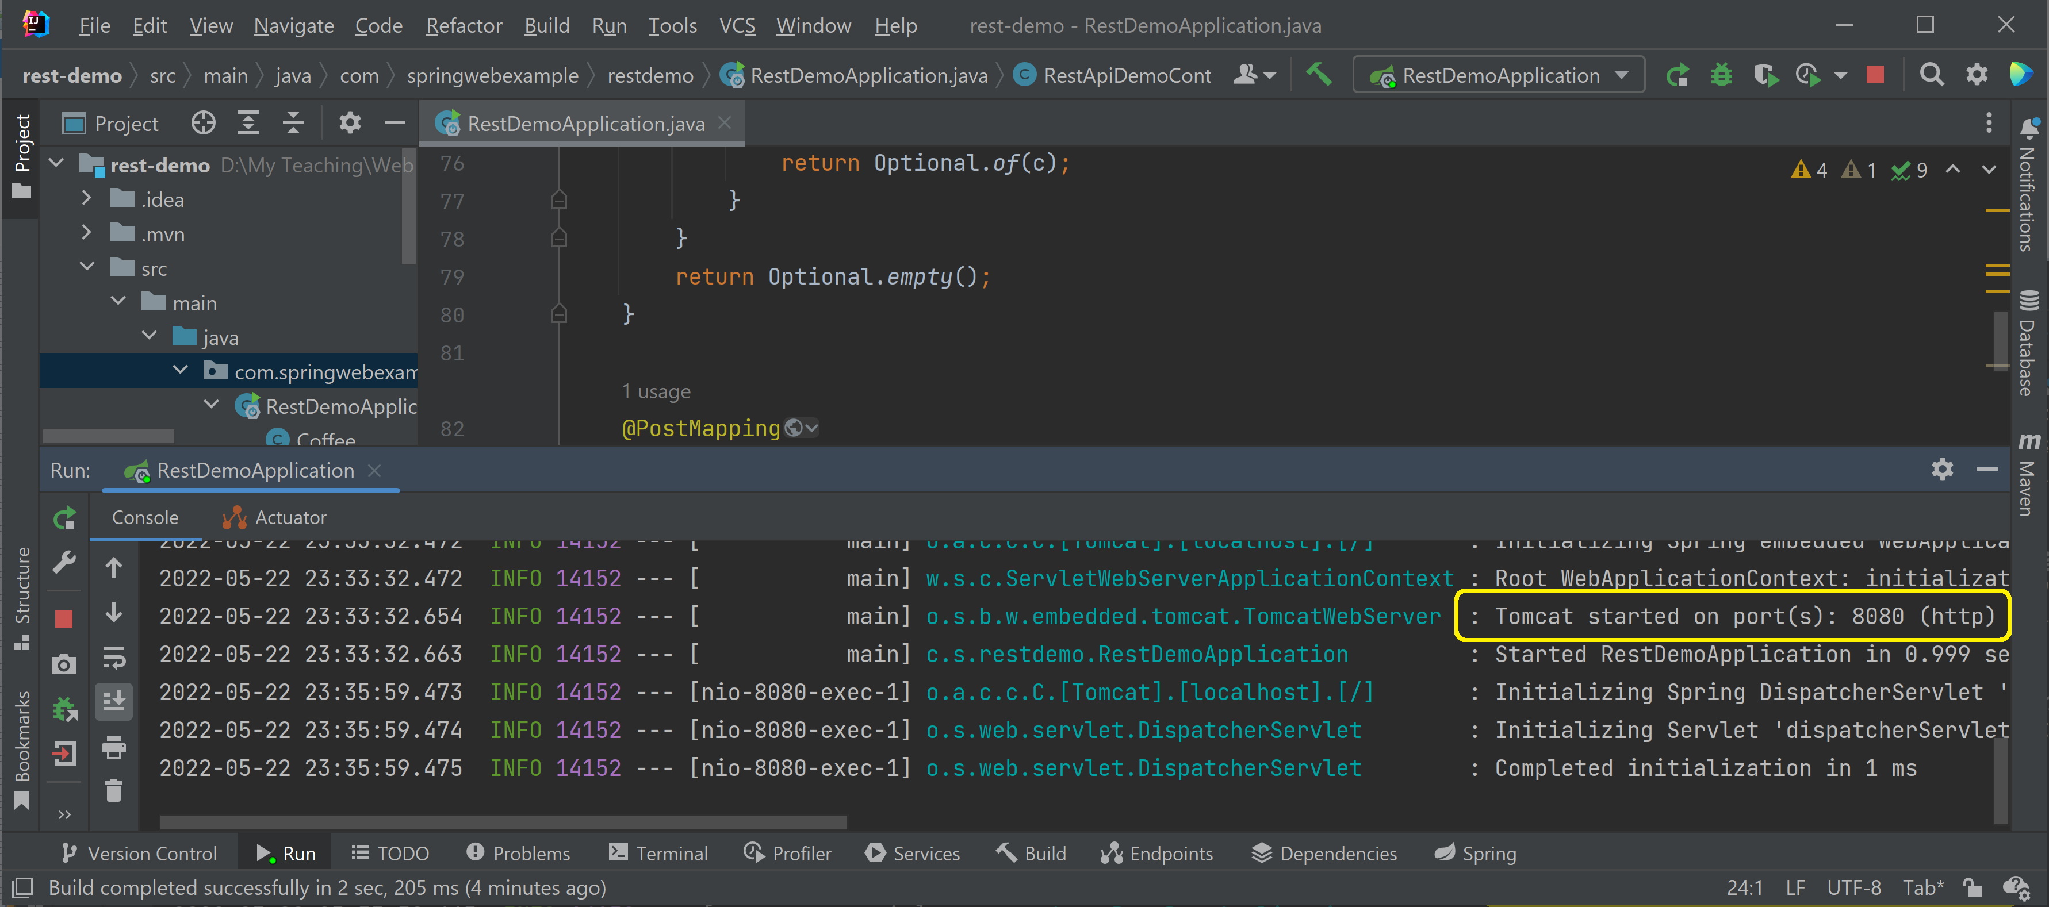
6. Run the Application

Slide 22
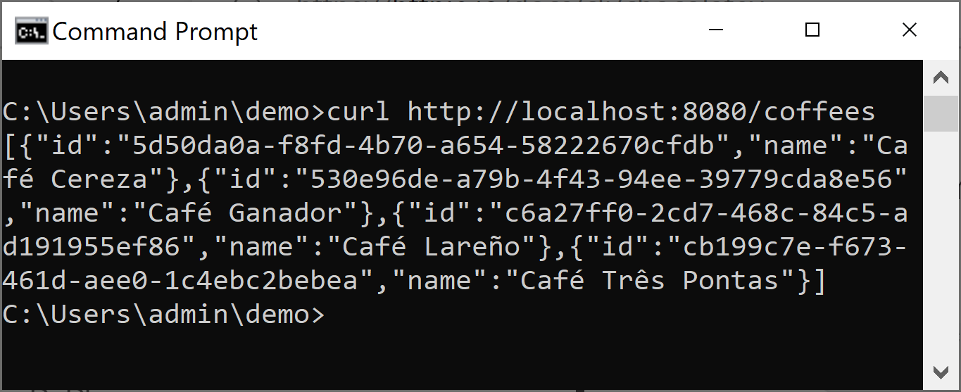
7. Test the APIs
curl http://localhost:8080/coffees

Slide 24
Web Application
A web application consists of a required directory structure.
Additional files and directories can be added to a web application, but the directory structure is the same for all web applications.
The web application structure is defined in the Java Servlet specification.

Slide 25
Servlet Engine
Web applications are hosted in servlet engines.
Each servlet engine will have a special location for web applications.
For the Tomcat servlet engine, web applications should be located in a directory named webapps.

Slide 26
Java Archive [JAR] Files
Java Archive [JAR] files are actually zip archives with the extension .jar that can be read by the Java Virtual Machine [JVM].
Typically, a developer who wants to add a feature to the servlet engine will package all the necessary class files in a JAR.
Creating applications that require multiple JAR files can be difficult, because of all the dependencies between JAR files.
A JAR file might be required for compiling, while additional JAR files are needed at run time.

Slide 27
What is Maven?
Maven is a tool that facilitates adding JAR files to an application.
Maven maintains a registry of JAR files, so it is easy to find a file.
Maven records the dependencies of JAR files and adds all the related JAR files to the library.
As time progresses, JAR files are updated. Maven makes it easy to upgrade the JAR files in an application.

Slide 28
Maven Web Application
Typically, a new Maven project is created from an archetype.
An archetype contains the base files for a standard application type.
Maven can run from the command line or from inside a popular IDE.
Most IDEs have an option to create a Maven project.

Slide 29
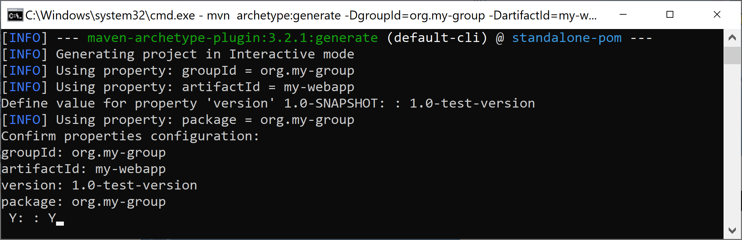
1. Create a Web Application
mvn archetype:generate -DgroupId=org.my-group -DartifactId=my-webapp -DpackageName=com.my-package -DarchetypeArtifactId=maven-archetype-webapp
maven-archetype-webapp: the webapp archetype.

Slide 30
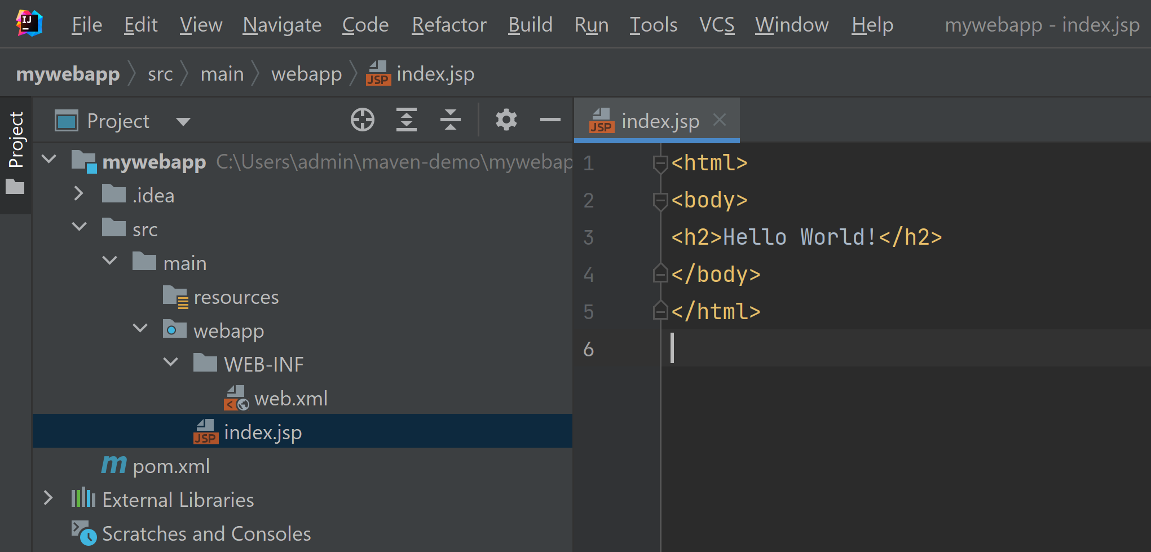
2. Open the Web Application

Slide 31
3. Add the war Plugin to pom.xml
https://maven.apache.org/plugins/index.html
...
<build> <finalName>my-webapp</finalName> <plugins> <plugin> <groupId>org.apache.maven.plugins</groupId> <artifactId>maven-war-plugin</artifactId> <version>3.3.2</version> </plugin> </plugins> </build> </project>

Slide 32
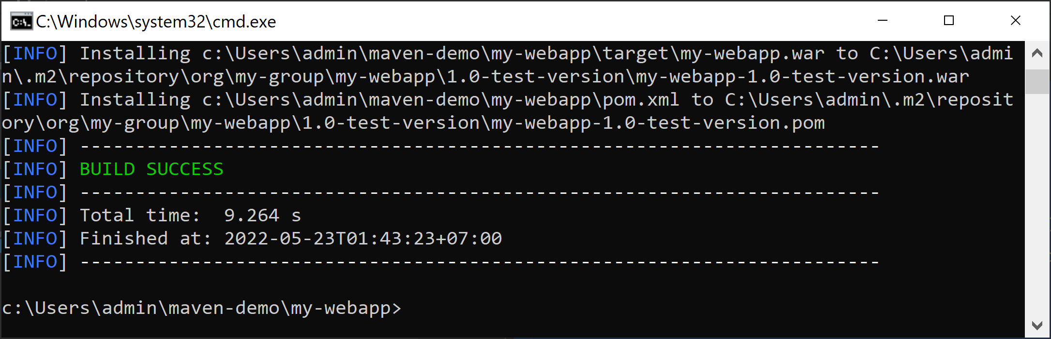
4. Install the war Plugin
cd my-webapp
mvn install

Slide 33
Servlet Engine in Maven
A servlet engine is needed in order to process dynamic content. A popular servlet engine is Tomcat.
Maven has a plugin for adding the Tomcat servlet engine to an application.
By adding this plugin to the pom file, the application can start its own Tomcat engine and display dynamic content. The default port for Tomcat is 8080.
The pom file is the configuration file for Maven. Using XML, it contains all the top-level dependencies requested for the application.

Slide 34
5. Add a Servlet Engine
https://tomcat.apache.org/maven-plugin.html
...
<plugins> <plugin> <groupId>org.apache.tomcat.maven</groupId> <artifactId>tomcat7-maven-plugin</artifactId> <version>2.2</version> <configuration> <port>8282</port> </configuration> </plugin> </plugins> </build> </project>

Slide 35
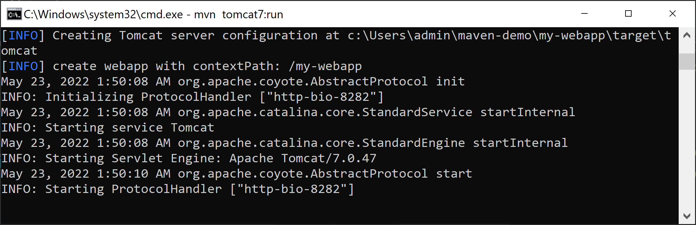
6. Run the Servlet Engine
mvn install
mvn tomcat7:run
curl http://localhost:8282/my-webapp/index.jsp

Slide 37
Java Server Page
A Java Server Page [JSP] contains HTML tags and plain text, just like a regular web page.
In addition, a JSP can contain Java code that is executed when the page is displayed.
Starting with the servlet specification 2.0, a language was added to JSPs that simplifies access to objects that are available to a JSP.
This language is known as the Expression Language [EL].
EL statements start with a dollar sign and are surrounded by curly braces.

Slide 38
JSP and EL Demo

Slide 39
From JSPs to Servlets
JSPs look like HTML pages, but they can generate dynamic content.
JSPs are abstractions: they are translated into Java programs known as servlets.
The program that translates them into servlets is known as the servlet engine.
Servlets only contain Java code.
All the plain text from the JSP has been translated into write statements.
The EL statements have been translated into complicated Java expressions.

Slide 40
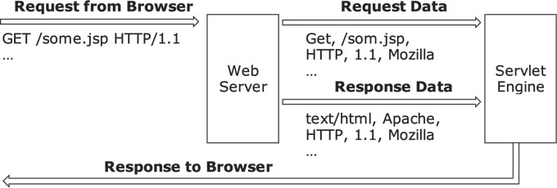
What is Servlet Engine?
Web servers know how to deliver static content, but need separate programs to handle dynamic content.
A servlet engine is a program running on the server that knows how to execute JSPs and servlets.
Some popular servlet engines are Tomcat, GlassFish, and JRun.

Slide 42
https://micronaut.io/

Slide 43

Thank You & See You Again

